Slide 1
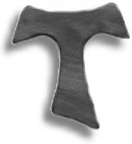
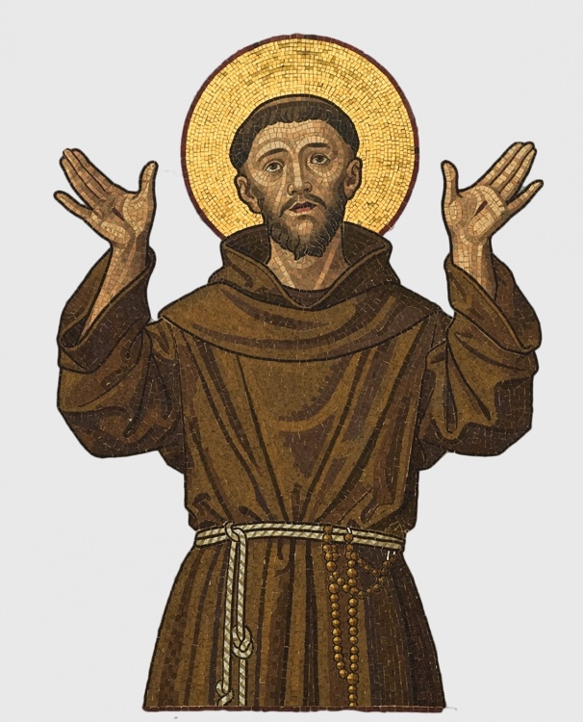
Secular Franciscan Order
(Third Order of St. Francis)
Follow Jesus in the Footsteps of St. Francis
as a Lay Person
Open Meeting
Date
@ time
in the
ALL WELCOME
For further details please contact
Phone:
Email:
Website: ofsireland.org

